Slide 1


Making course content accessible
PRESENTATION BY:
Nicolaas Matthijs
Notes:
v

Slide 2
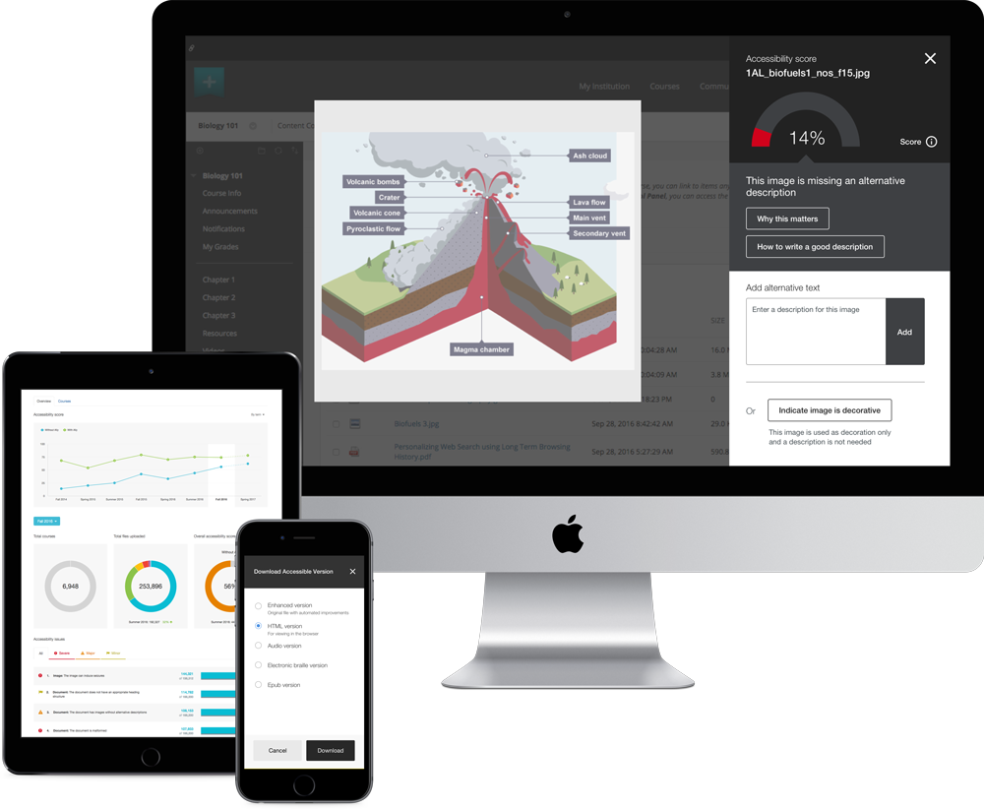
Demo

Slide 3
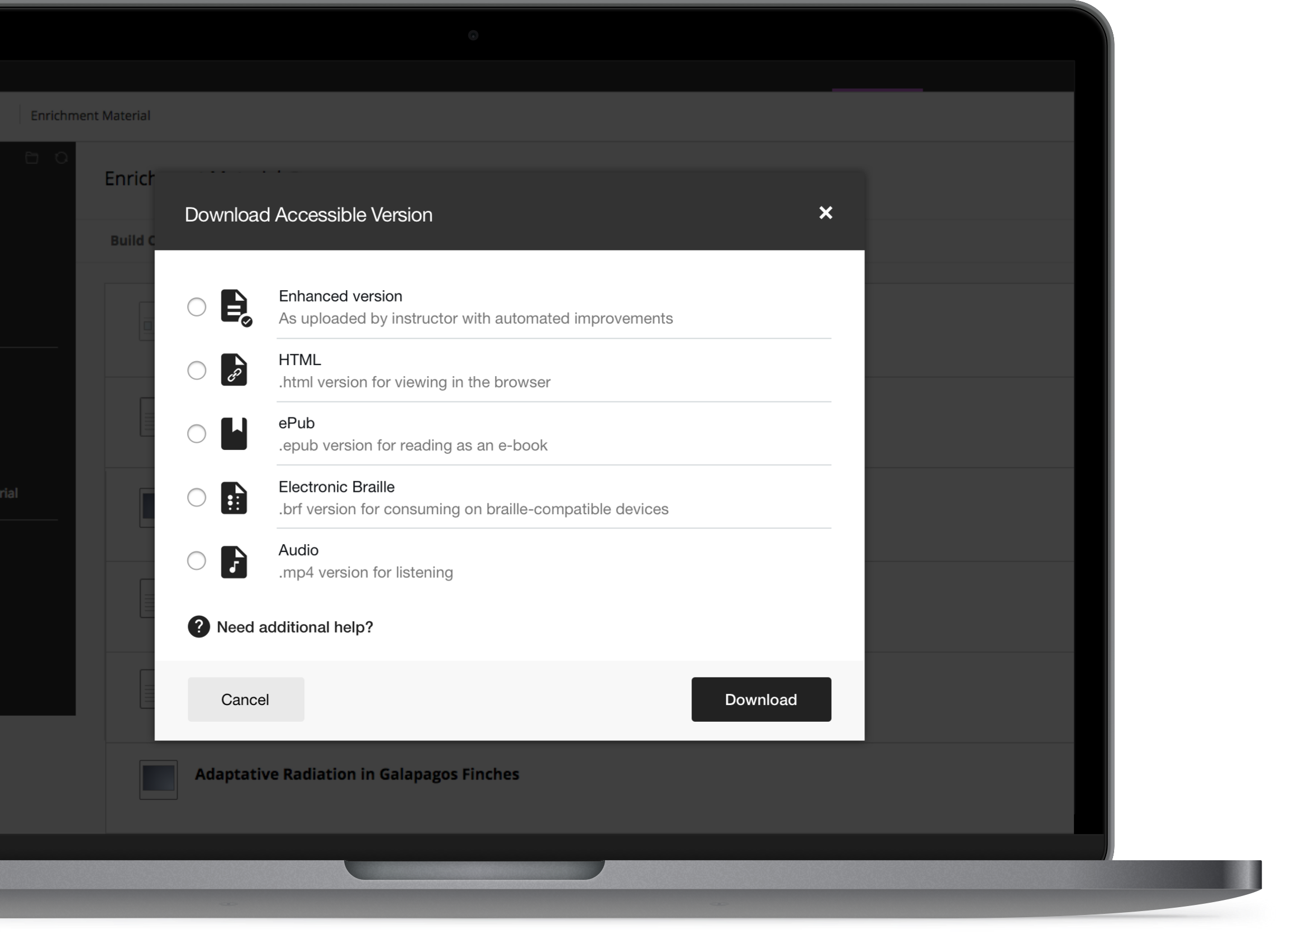
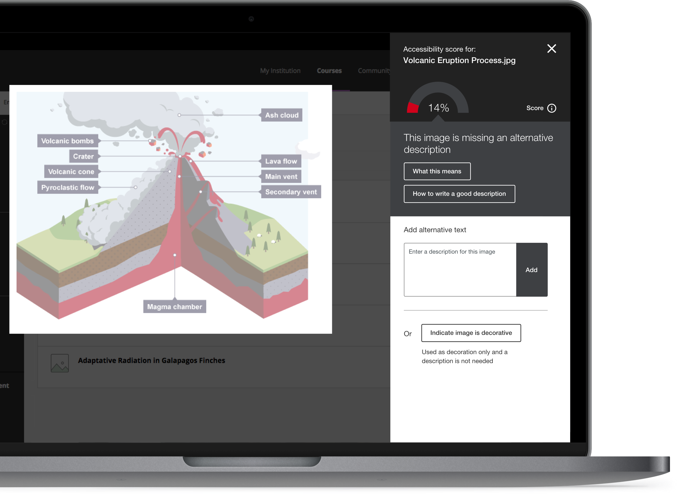
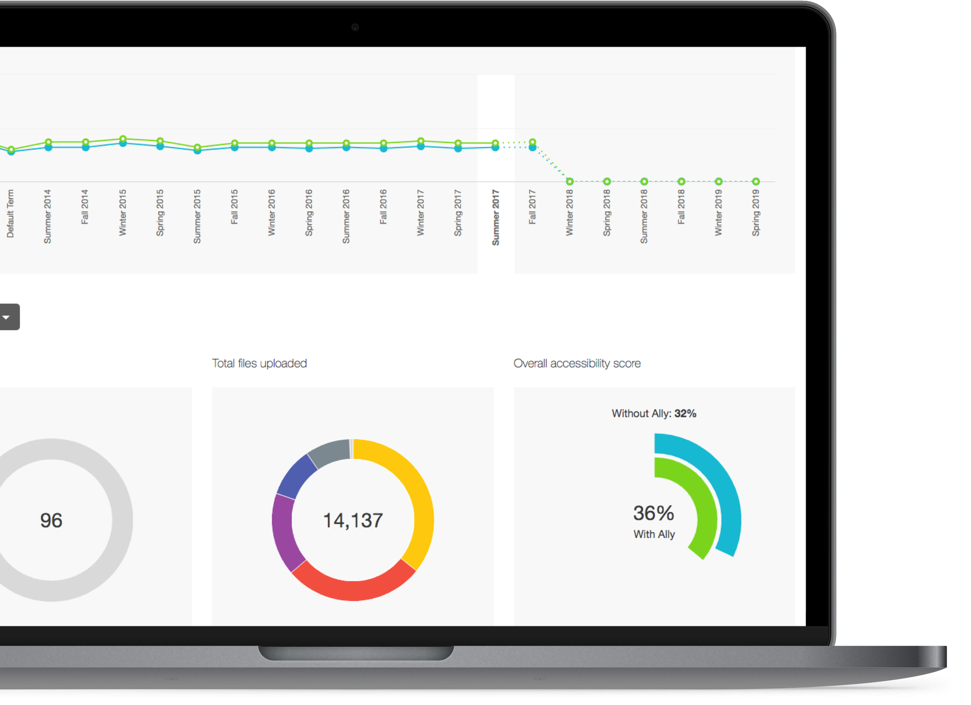
Alternative Formats
Instructor Feedback
Institutional Report
Automatically checks for accessibility issues and generates alternative formats.
Guides instructors on how to improve the accessibility of their course content and alters future behavior.
Provides detailed data and insights to help further improve course content accessibility at the institution.

Slide 4
Introducing Ally for Websites
Our next step within the accessibility ecosystem
Promotes the value of accessible content outside of the LMS
Provides a consistent approach to making course and web content accessible

Slide 5
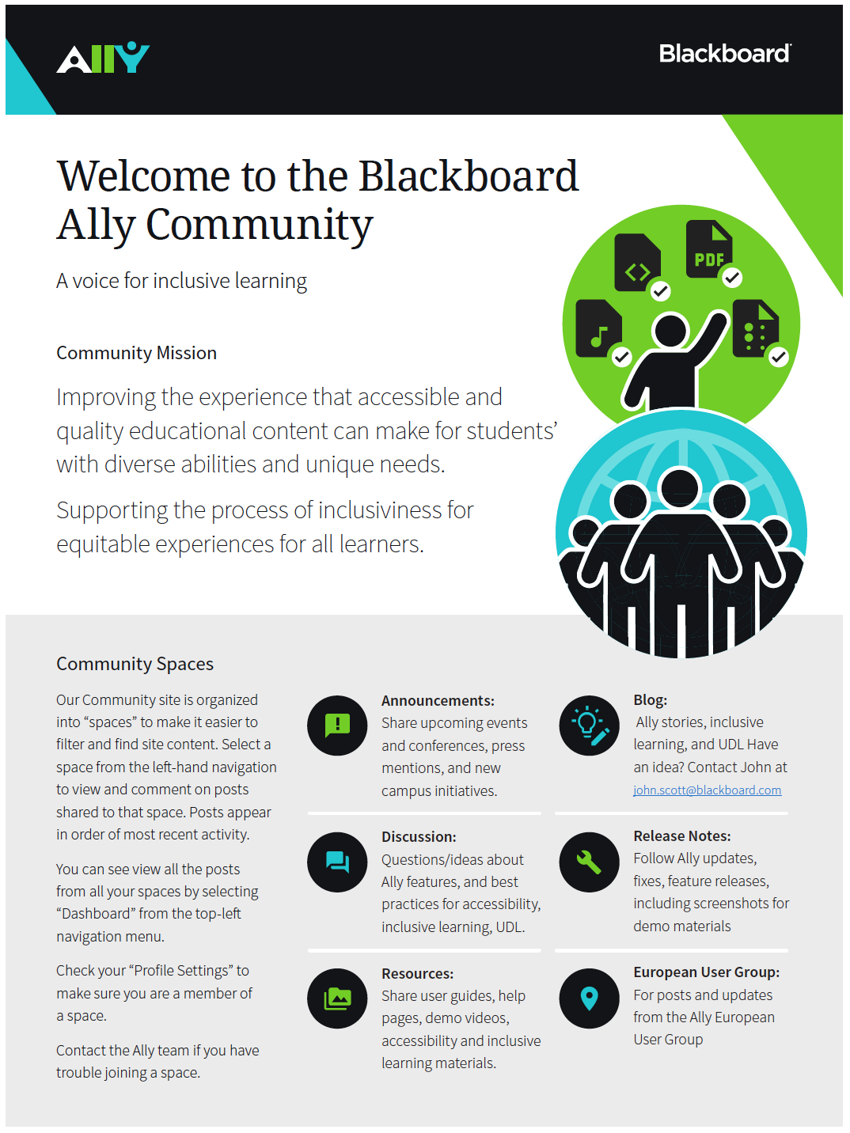
Ally User Group
Participate in UX research, usability testing, early access, etc.
Discussions with other institutions
Implementation stories
Adoption & Communication Toolkit
http://usergroup.ally.ac

Slide 6
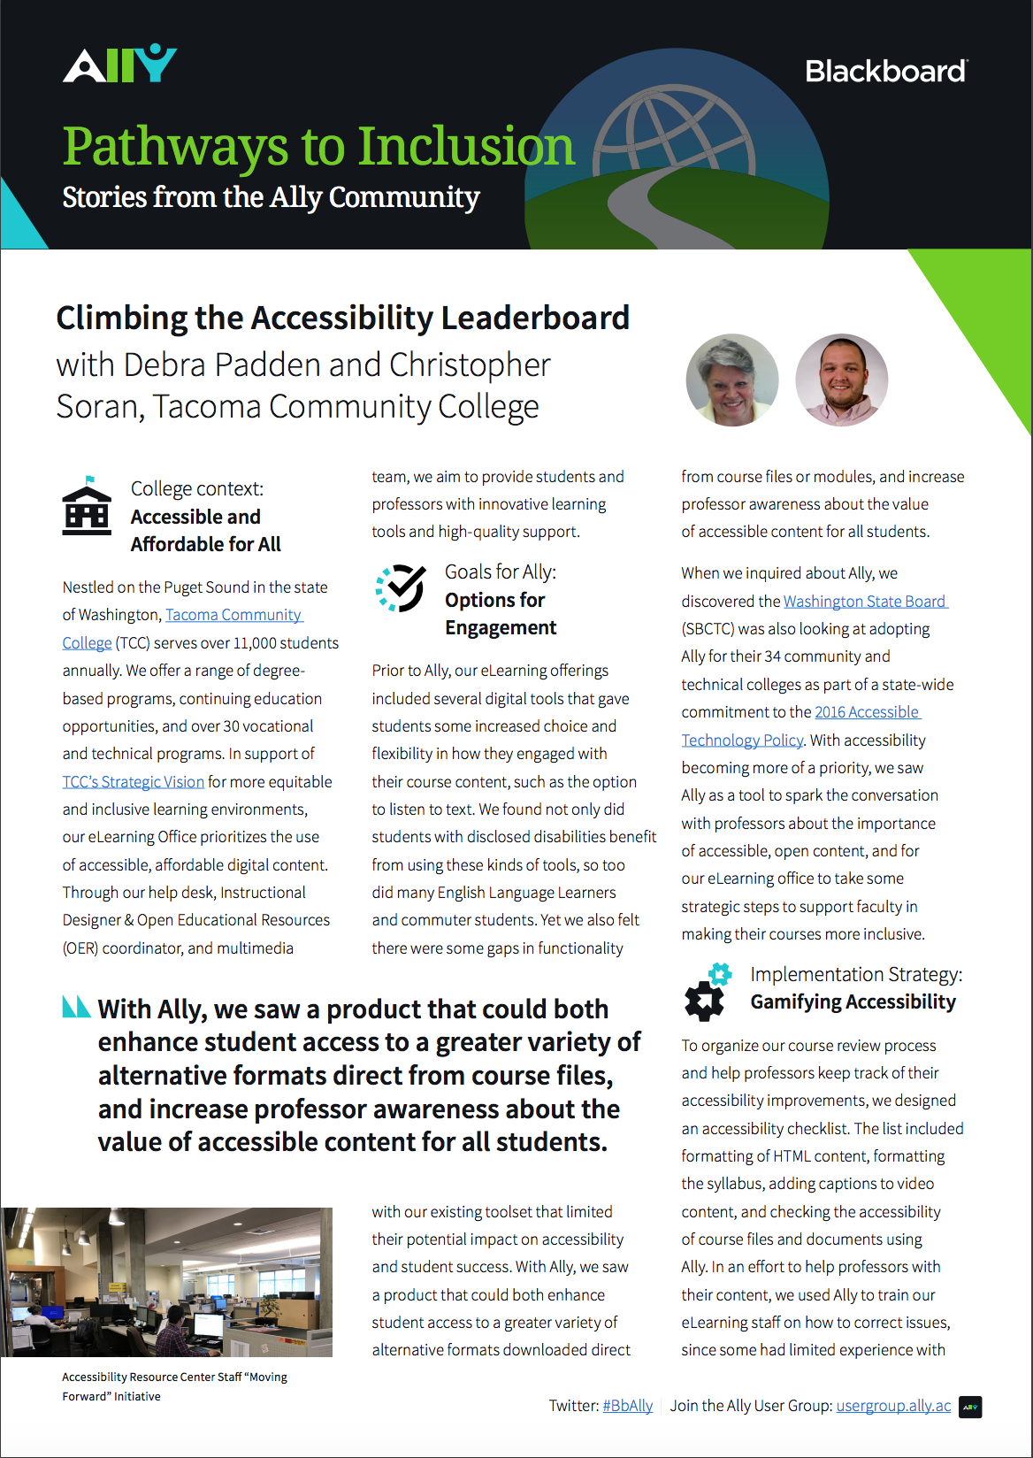
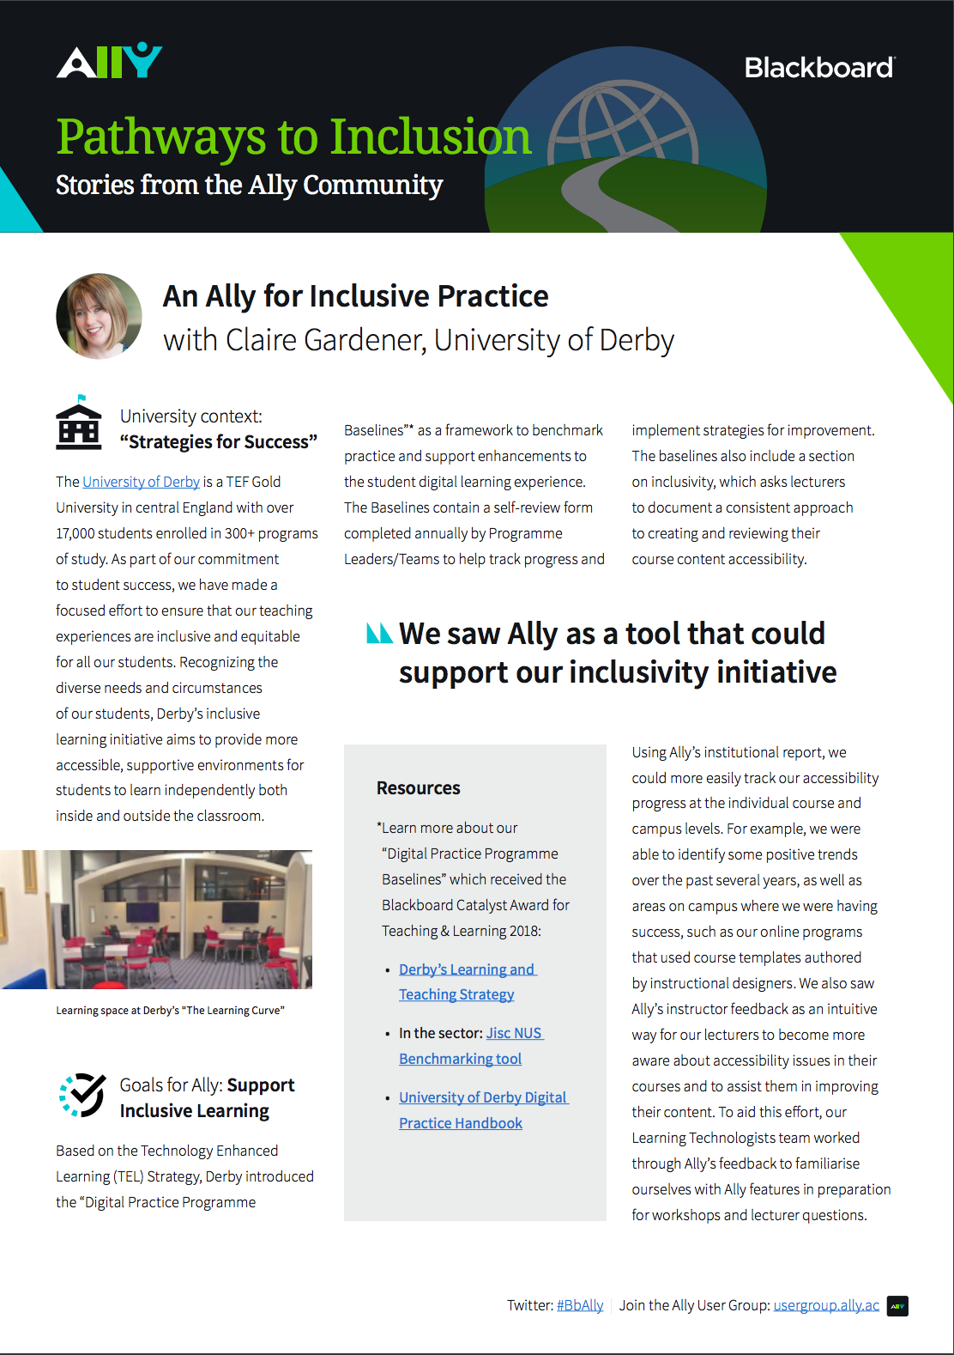
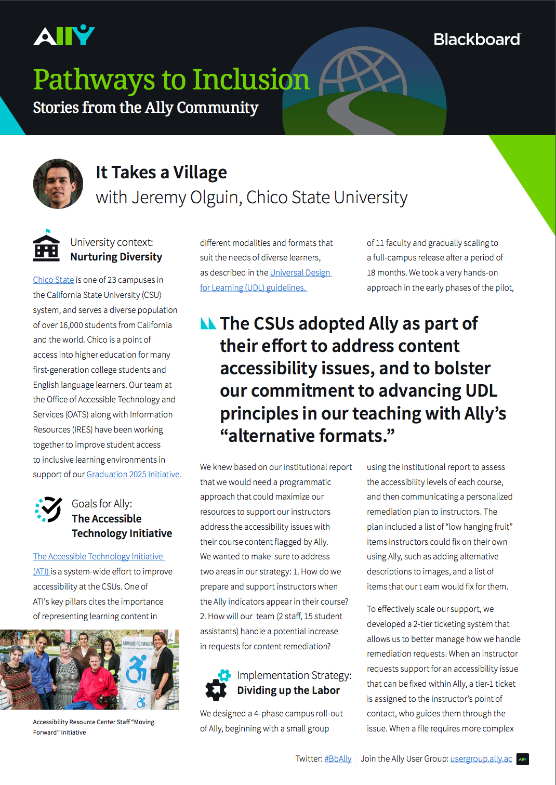
Ally Case Studies
Tacoma Community College
University of Derby
CSU Chico

Slide 7
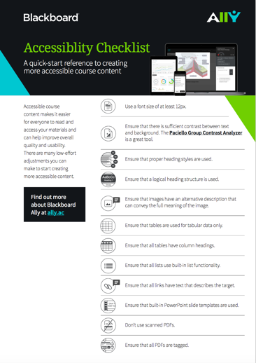
Accessibility Checklist
12 basic guidelines to help create more accessible content
Hand-out that can be shared with instructors
http://tinyurl.com/bb-accessibility-checklist

Slide 8
Coming Up
Accessibility for Everyone?
Christopher Phillips, Utah State University
2:30 – 3:10PM – Creston Peak 1-2

